Slide 1
TEAM 04-Event Association
Presented By:-
Rajwinder Kaur(13456276)
Navjot Kaur(13532220)
Anubha(13490509)
Rajat Chahal(13489891)

Slide 2
OBJECTIVE
Event Management is the planning and management of an event ,project or any activity. The Target of Occasion Administration Framework is to build up an online application utilizing which client can see different bundles identified with occasion and furthermore reach us to compose their occasion, for example, Music, Dancing, sports occasion ,new year celebration and so forth.

Slide 3
TARGET USERS
Essential Users : A visitor client who just wishes to access to nuts and bolts data from our site for up and coming occasions.
Auxiliary Users : People who wish to wind up part with our site and might want to make their profession in occasion association.

Slide 4
FEATURE OF EVENT MANGEMENT SYSTEM
(1) Client can investigate different occasion online via seating at their home or office.
(2) Client can look for accessible date for their occasions.
(3) Client can be a part of our organization by joining our membership service.
(4) Client can give input for development in administrations and qualities.

Slide 5
MORE FEATURES(Writing Skills):-
Interactive Display.
HD Images with event description related the detail of event and venue.
Responsive and mobile friendly.
Concise and readable content.
Contrasting Colors.
Well organized and presented information properly divided into sections and categories for easy navigation.
Compatible with all browsers.

Slide 6
FRONT-END REQUIREMENT:
Dreamweaver: Adobe Dreamweaver is an application used by web designers and developers to create websites and applications for use across multiple targets including browsers, devices, and tablets.
HTML5: HTML5 is a markup language used for structuring and presenting content on the World Wide Web. It is the fifth and current version of the HTML standard.
Javascript: It is a object-oriented , multi-paradigm scripting language that is dynamic, and supports object-oriented, imperative, and functional programming styles.
CSS Style Sheets: CSS is a language that describes the style of an HTML document. CSS describes how HTML elements should be displayed.
JAVA: Java is a widely used programming language expressly designed for use in the distributed environment of the internet.

Slide 7
BACK-END REQUIREMENT:
Oracle 12C : Oracle Database 12c makes the process far faster and simpler, enabling the high density of schema-based consolidation—without requiring changes to existing applications.
Oracle 12C is the first database designed for the cloud.

Slide 8
MAIN FUNCTIONS:-
Home
Events
Membership
About us
Contact us

Slide 9
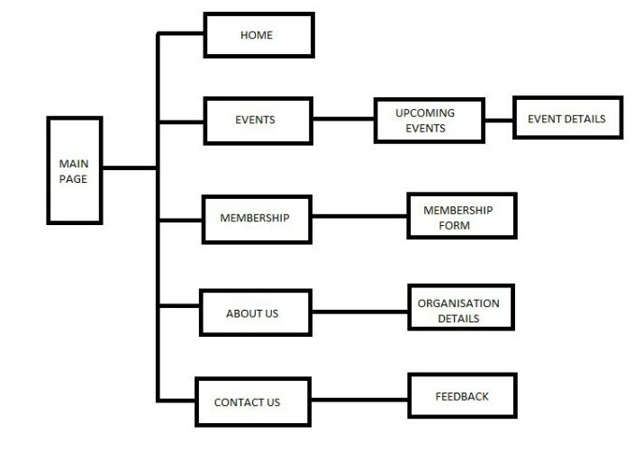

Slide 10
DATA REQUIREMENTS
Event Information includes
Event Title
Event Description
Venue
Date and Time
Charges per person

Slide 11
Membership information includes
Name
Date of birth
Company Information(Company Name, Address, Contact no, email-id)
Queries
Event
Type of Event
Date and time(Choice 3)
Total Number Of Person

Slide 12
RESPONSIBILITIES
Home - Rajwinder Kaur
About Us and Contact Us and Back-end - Navjot Kaur
Events – Anubha
Membership - Rajat Chahal

Slide 13


